Slide 1










STEP 1: INDICATOR SELECTION
(separation into exposure & sensitivity)
STEP 4: CHARACTERISTIC AGGREGATION
STEP 3: INDICATOR AGGREGATION
Existing Natural Hazard Risk (static)
Emerging Natural Hazard Risk (dynamic)
STEP 2: BOUNDED NORMALISATION
(with high and low risk thresholds for each indicator)
Existing Food Security Risk (static)
Emerging Food Security Risk (dynamic)

Slide 2

STEP 1: INDICATOR SELECTION AND GROUPING
(separation into exposure & sensitivity)
STEP 3: INDICATOR AGGREGATION
STEP 4: ASSIGN CHARACTERISTIC RISK LABEL
STEP 2: BOUNDED NORMALISATION
(with high and low risk thresholds for each indicator)
Compound Risk Score
(separate scores for emerging and existing risk)
STEP 5: CALCULATION OF TOTAL RISKS FLAGS

Slide 3
Compound Disaster Risk
Natural Hazards
Food security
Conflict and Fragility
Macro-economic risk
Fiscal risk
Socio-economic vulnerability
Covid Response Capacity

Slide 4



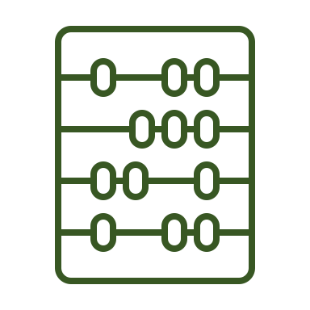


INDICATORS
Conflict and fragility
RISK COMPONENTS
Fiscal risk
Natural hazard
TOTAL COMPOUND RISK
(separate scores for emerging
and existing risk)
Macro-economic exposure
Food security
Socioeconomic vulnerability
COVID response capacity

